Slide 1
TAXES, TAXES, TAXES
Tom Osborne
April 12, 2021

Slide 2
But I don’t know ANYTHING about taxes!

Slide 3
But I don’t know ANYTHING about taxes!
Do you know how to read?
Do you know how to add and subtract?
Do you know your name?
Do you know how to write your name on a form?

Slide 4
But I don’t know ANYTHING about taxes!
Do you know how to read?
Do you know how to add and subtract?
Do you know your name?
Do you know how to write your name on a form?
CONGRATULATIONS!!! You have almost all of the skills you need to handle taxes!!!

Slide 5
Filing Deadlines
What’s the filing deadline?–
MOST years the filing deadline is April 15th. Due to the pandemic, the filing deadline for this year was extended to May 17th
What If I can’t get it done by May 17th? –
Submit Form 4868 by the May 17th deadline. This will give you an automatic 6-month extension of time to file.
So, what’s the catch? –
The extension gives you additional time to FILE your taxes. It does not give you additional time to PAY your taxes. If you owe money to the IRS, they will charge you interest on the amount you owe.

Slide 6
What you (probably) got in the mail
Income
W-2 Form – your employer has recorded how much they paid you and how much money was withheld in taxes
1099C Form – your employer considers you an “independent contractor”. They recorded how much money they paid you, but they probably did not withhold any money for taxes. For tax purposes you are your own business.
1099G Form – this lists any unemployment you may have received in 2020. Unemployment is taxable. It gets reported on Schedule 1 of the 1040.
Investments
1099INT – shows any interest you may have received. Traditionally from a bank, but it can also be from an investment account

Slide 7
What you (probably) got in the mail
Investments (Cont’d)
1099DIV– shows any dividend income you may have received during the year. Typically, this will come from an investment firm or account
1099B - shows any sales you may have done over the years on stocks or bonds. Typically, this will come from an investment firm or account
Insurance
1095C Form– shows proof that you were had health insurance under an employer health insurance plan.

Slide 8
Do I need to file?
In MOST cases, you MUST file if……….
Filing Status | Age | Gross Income
Single | Under age 65 | $12,400 or more
Married filing jointly | Under age 65 | $24,800 or more
Head of household | Under age 65 | $18,650 or more

Slide 9
Do I need to file if I am a dependent?
The rules are a bit different if you are considered a dependent (so somebody else is claiming you on their tax return)
If you are single, less than 65 years old, and not blind, do ANY of the following situations apply?
Did you make $1,100 or more in unearned income (investments)?
Did you make $12,400 or more in earned income?
Was your earned PLUS unearned income more than $1,100 OR you had earned income up to $12,050 plus $350
If you answered yes to any of these 3 questions, then you must file

Slide 10
Special Circumstances When You Must File

Slide 11
Must versus Should….
Even if you don’t HAVE to file a return, there are times when you should anyway.
You had a job and taxes were withheld, income was below the required reporting, but you may be eligible for a refund
You may be eligible for some tax credits (like Earned Income Credit). You can get a refund for much more than you paid in taxes.
IRS will never penalize you for filing when it’s not necessary. They WILL penalize you for NOT filing when you’re supposed to.

Slide 12
So, I need to file. Now what?
Complete Income Tax Forms
Form 1040 to report income and calculate taxes owed
Schedules apply based upon your situation. Below are the most common:
Schedule 1 – Additional Income and Adjustments (includes business income and unemployment)
Schedule A - Itemized Deductions
Schedule B – Interest and Ordinary Dividends
Schedule C – Profit or Loss From Business
Where Can I Get Tax Forms?
Library
Post Office
https://www.irs.gov/forms-pubs/about-form-1040

Slide 13
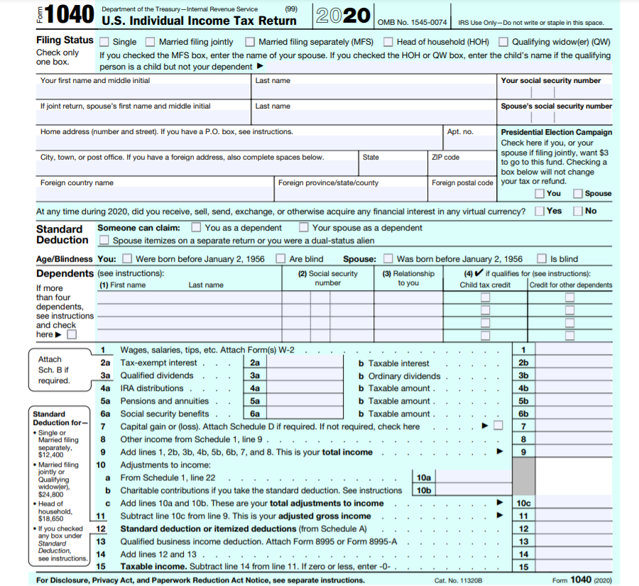
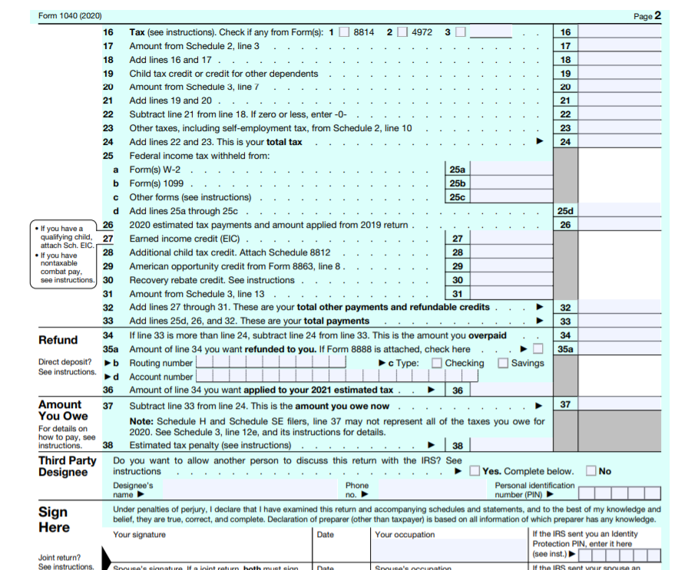

Slide 14
Standard Deduction And Dependents
Most of you are probably a dependent
IRS has detailed criteria for who is considered a dependent
Dependents can still file taxes, but may not be able to claim the entire amount of the standard deduction (see worksheet)

Slide 15
Income
Add up amounts from W-2 forms, 1099 forms
Instructions on the W-2, 1099 will tell you how to classify the income
Rule of thumb- if you don’t know what it is, it probably doesn’t apply to you

Slide 16
Deductions
What can I subtract from my income:
Educator Expenses, Self Employment Tax, Health Savings Account, IRA Deduction, Student Loan Interest, Tuition and Fee Deduction, etc.
Standard Deduction:
Single = $12,400
Should I Itemize? Which is better?

Slide 17
Tax Withholding
Taken right from the W-2 Forms, 1099 Forms
With tax credits, you may get more money back than was taken in taxes
Over 75% of Americans will get a refund (so more money was withheld than was owed)

Slide 18
2020, A Year Like No Other
I received a stimulus check in 2020. Do I have to pay taxes on it?
Answer: No, you do not have to claim your stimulus check on your taxes.
I should have gotten a stimulus check, but I never received it. Can I still get a stimulus check?
Answer: you can still get the benefit by claiming a “rebate recovery credit” on your 2020 tax return. It will count as a credit against your 2020 tax bill.
https://www.thetaxbook.com/updates/TheTaxBook/Client%20Tax%20Tools/Recovery%20Rebate%20Credit%20Worksheet.pdf
I received unemployment in 2020. Is that taxable?
Answer: Yes, unemployment benefits are taxable.
I was out of work for most of 2020. How does that effect my earned income credit?
Answer: You can opt to use your 2019 income totals instead of 2020 income totals

Slide 19
Help!
New York City offers free online tax prep services
Income Based, designed for low to middle income taxpayers
Virtual help or in person services
https://www1.nyc.gov/site/dca/consumers/file-your-taxes.page
IRS Volunteer Income Tax Assistance Program (VITA)
Income Based, designed for low to middle income taxpayers
Bring valid ID and all your tax forms (W-2, 1099, 1095-etc) with you
Offers free electronic filing
https://irs.treasury.gov/freetaxprep/jsp/vita.jsp?zip=11105&lat=40.7787902&lng=-73.9065883&radius=5

Slide 20
Help!
Internal Revenue Service
If your Adjusted Gross Income is $72,000 or Less
Partners with various private tax preparation services
Guided tax preparation to complete the tax forms
Free electronic filing of US tax return
Free electronic filing of state return (with some programs)
If your Adjusted Gross Income is Over $72,000
You must fill out the tax forms yourself
Program performs simple math checks and limited guidance
Does not include state returns
Free electronic filing of US tax return
See: https://www.irs.gov/e-file-providers/free-file-fillable-forms

Slide 21
I’m Undocumented. What Should I Do?
You should discuss your particular situation with an immigration attorney!
But here’s what you should know about taxes…..
You still have a legal obligation to pay taxes
Many undocumented workers will use the fact that they have filed US tax returns as proof of residency and to establish how long they have been in the US
Form W-7 to request an Individual Taxpayer Identification Number (ITIN)
The ITIN does NOT change your legal status

Slide 22
Tax Breaks for College
American Opportunity Tax Credit
Lifetime Learning Tax Credit
Student Loan Interest Deduction
Tuition and Fee Deduction
Additional Benefits and Programs

Slide 23
Tax Breaks for College
American Opportunity Tax Credit
Credit of up to $2,500 per year per student for the first 4 years of higher ed
School must provide you with a Form 1098-T proving you are eligible
Complete IRS Form 8663 to claim the credit
Who is eligible?
Must be pursuing a degree of “recognized education credential”
Enrolled at least half time for at least 1 academic period
Not have finished the first 4 years of higher ed at the beginning of the tax year
Cannot have claimed the AOTC for more than 4 years
Cannot have a felony drug conviction
Bottom line, AOTC is designed for undergraduate degrees

Slide 24
Tax Breaks for College
Lifetime Learning Tax Credit
Credit of up to $2,000 per year per student.
Can use for undergraduate, graduate, or professional degrees, including courses to improve job skills
No limit to the number of years you can take the credit
Complete Form 8663 to claim benefit (same as for AOTC)
Who is eligible?
Must be enrolled or taking classes at an “eligible educational institution”
Must be working toward a degree or getting/ improving job skills
Be enrolled for at least one academic period beginning in the tax year
You CANNOT claim both the AOTC and the LLTC for the same student in the same tax year

Slide 25
Tax Breaks for College
Student Loan Interest Deduction
Can deduct up to $2,500 of the interest paid on student loan during the year
Complete Schedule 1 worksheet and report on line 20
Rules Apply:
Make under $85,000 if single / $170,000 if married filing jointly
Be the person legally responsible for the loan
Doesn’t qualify as student loan if any of the money used for anything else
Specific guidelines regarding what counts as education expenses and what counts as an institution of higher learning

Slide 26
Tax Breaks for College
Tuition and Fee Deduction
Can deduct up to $4,000 of tuition and fees for higher education
Cannot claim deduction if married filing separately
Make under $80,000 if single / $160,000 if married filing jointly
Cannot take the deduction if another person can claim you as a dependent
Specific guidelines regarding what counts as education expenses and what counts as an institution of higher learning
Complete Schedule 1 report on line 21
Tax Year 2020 is the last year you can claim Tuition and Fee Deduction

Slide 27
State Taxes
NY State Returns are based on Fed Tax Return, so need to complete Fed Return first
Typically, if you had to file a federal return and you live in New York then you have to file a state return
NY State filing is due May 17th (same as federal)
Where to begin?
https://www.tax.ny.gov/pit/file/residents.htm

Slide 28
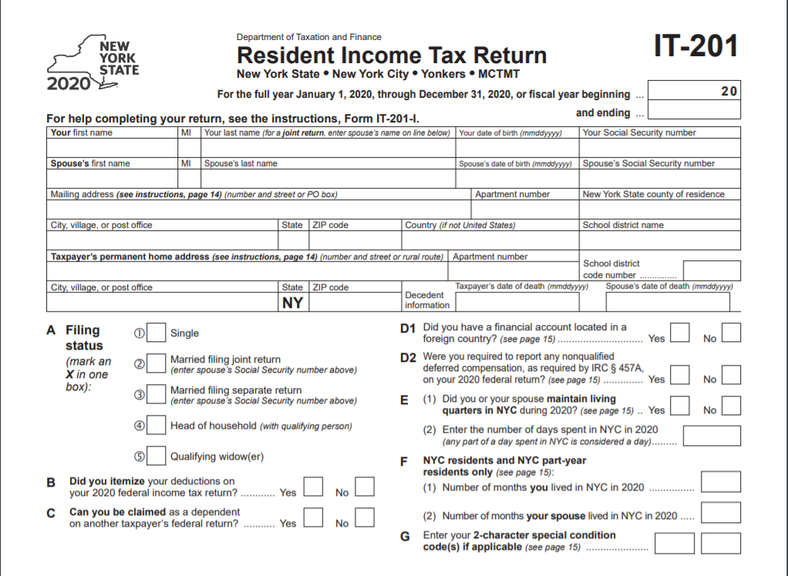
NY State Form IT-201
Note: Depending on where you live, NY also has local taxes on top of state taxes. NYC residents pay both state and local taxes on the same form.

Slide 29
File State Return Electronically

Slide 30
Tricks of the Trade

Slide 31
Tricks of the Trade

Slide 32
APPENDIX
Some additional charts and definitions you might find helpful

Slide 33
Definition of a Qualifying Child
Son, daughter, stepchild, foster child, brother, sister, stepbrother, stepsister, half brother, half sister, or a descendant of any of them (for example, your grandchild, niece, or nephew)
AND
Under age 19 at the end of 2020 and younger than you
OR
Under age 24 at the end of 2020, a student (defined later), and younger than you
OR
Any age and permanently and totally disabled (defined later)
AND
Who didn't provide over half of his or her own support for 2020 (see Pub. 501)
AND
Who isn't filing a joint return for 2020 or is filing a joint return for 2020 only to claim a refund of withheld income tax or estimated tax paid (see Pub. 501 for details and examples)
AND
Who lived with you for more than half of 2020. If the child didn't live with you for the required time, see Exception to time lived with you, later

Slide 34
Is Your Qualifying Child a Dependent?
Child was a US citizen, US national, resident alien, a resident of Canada, or a resident of Mexico
Yes – Continue No – Stop. Not a Dependent
Was your child married?
No – Continue Yes – Review Rules for Married Children
Can you be claimed as a dependent on someone else’s return?
No – You can claim Yes – You cannot claim them

Slide 35
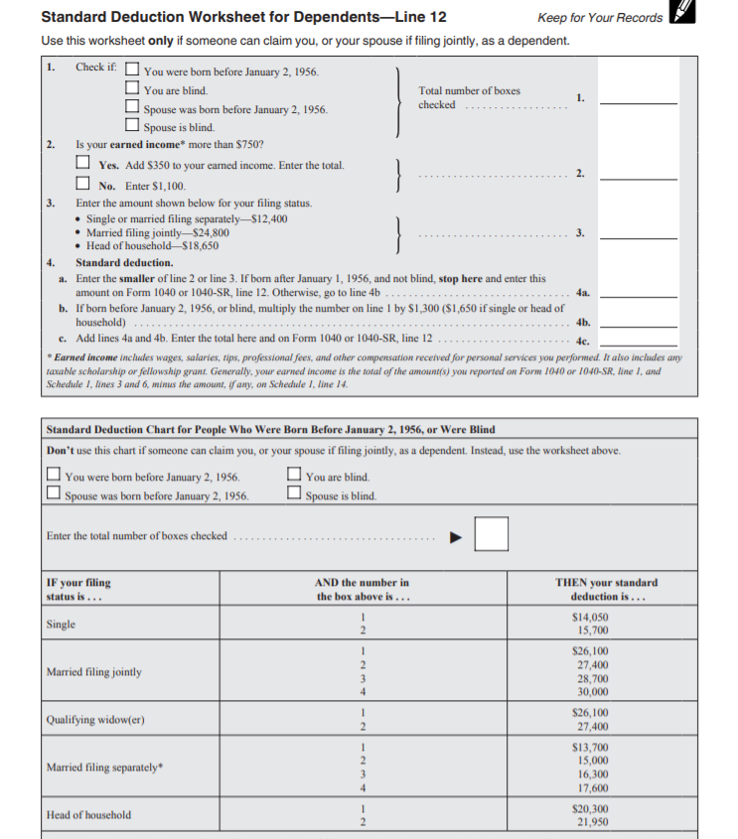

Slide 36
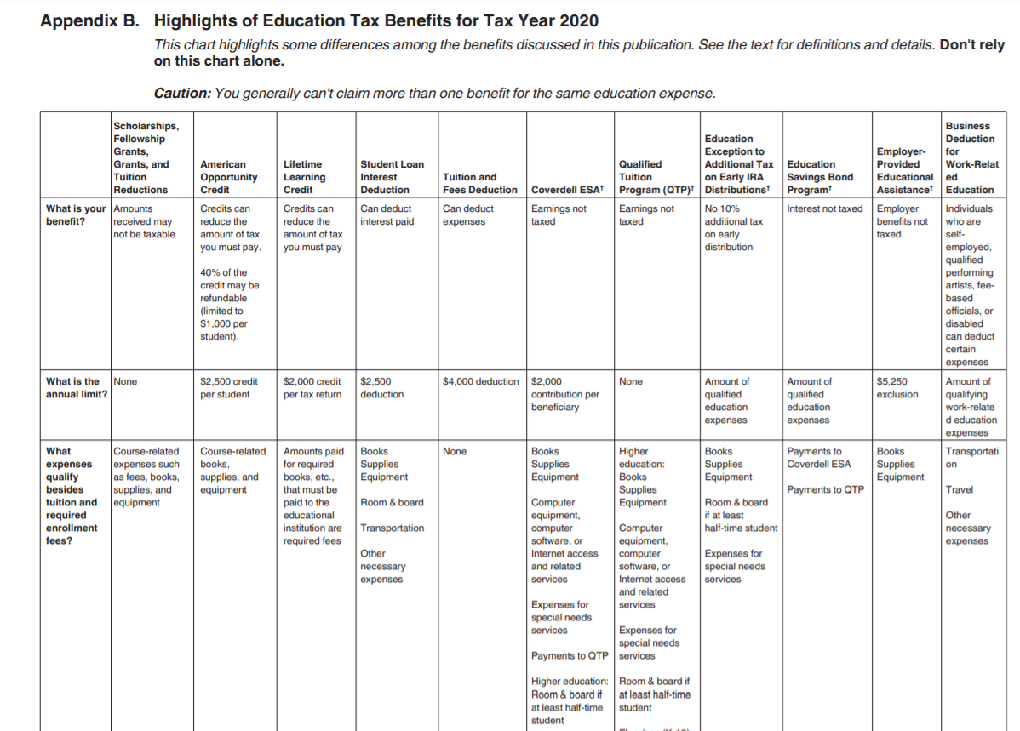

Slide 37
